Slide 1

Predictive Analytics in Business (BUAN 448)
Association Rules
(Chapter 14)
BUAN 488 – Fall 2022 – Dr. Davoodi

Slide 2
Review Previous Lessons
Unsupervised:
Chapter 3: Data Visualization and Exploration
Supervised:
Chapter 6: Multiple Linear Regression
Chapter 10: Logistic Regression
Chapter 11: Neural Nets
Chapter 7: k-Nearest Neighbors (kNN)
Chapter 5: Evaluating Predictive Performance
Unsupervised:
Association Rules
Cluster Analysis

Slide 3
Unsupervised Learning
Goal: Segment data into meaningful segments; detect patterns
There is no target (outcome) variable to predict or classify
Methods: Association rules, data reduction, data exploration, visualization, clustering

Slide 4

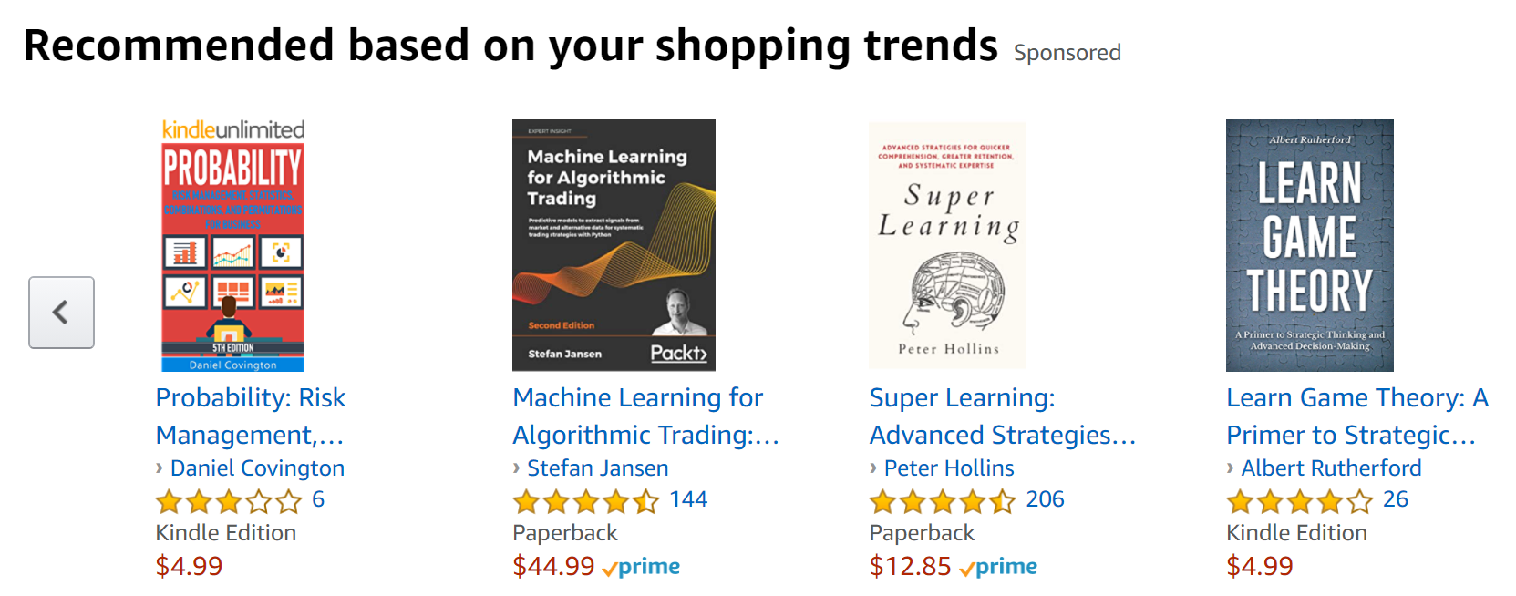
Recommendation System

Slide 5
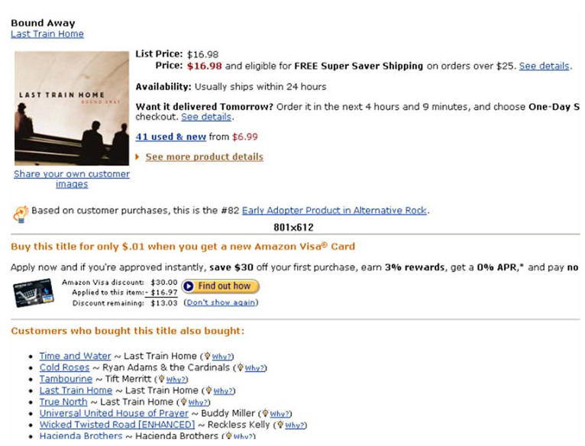
Recommender Systems

Slide 6
What are Association Rules?
Study of “what goes with what”
“Customers who bought X also bought Y”
Transaction-based or event-based
Unsupervised learning methods

Slide 7


What are Association Rules?
Also called “market basket analysis” and “affinity analysis”
Originated with study of customer transactions databases (bar-code scanners) to determine associations among items purchased:
These items can be:
Displayed together
Offered post-transaction coupons
Recommended in online shopping
…
Discovering which groups of products tend to be purchased together

Slide 8
Generating Rules

Slide 9
Generating Rules
Goal: examine all possible rules between items in an if-then format, and select only those that are most likely to be indicators of true dependence

Slide 10
Terms
“IF” part = antecedent
“THEN” part = consequent
“Itemset” = the items (e.g., products) containing the antecedent or consequent
Note:
Antecedent and consequent are disjoint (i.e., have no items in common)
Itemsets are not records of what people buy; they are simply possible combinations of items, including single items

Slide 11
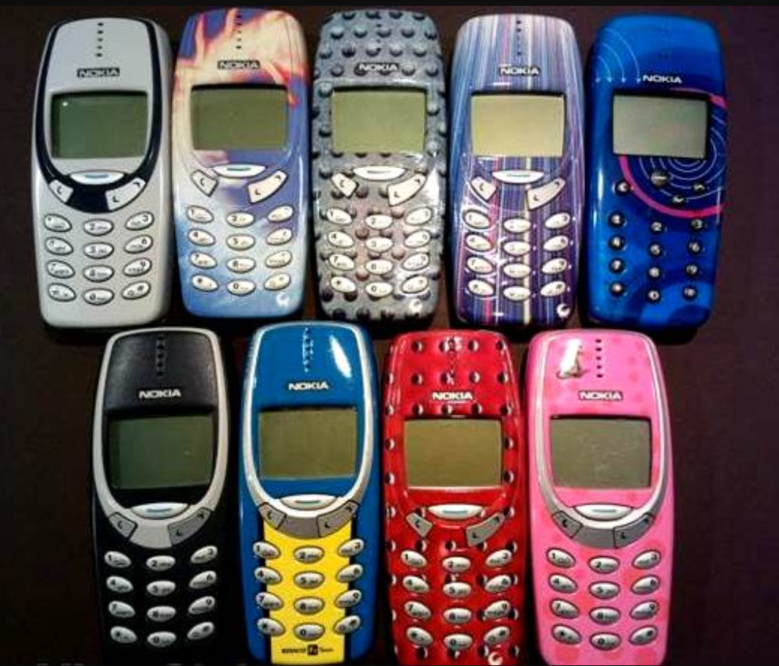
Tiny Example: Phone Faceplates
A store that sells accessories for cell phones runs a promotion on faceplates
Customers who purchase multiple faceplates from a choice of six different colors get a discount
The store manager would like to know what colors of faceplates customers are likely to purchase together

Slide 12
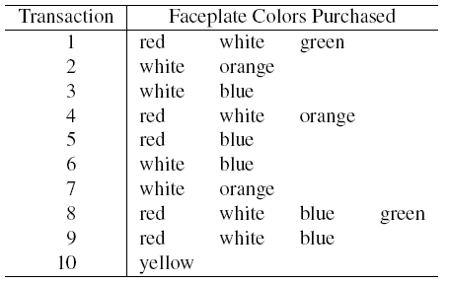
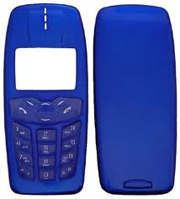
Tiny Example: Phone Faceplates

Slide 13
Many Rules are Possible
For example: Transaction 1 supports several rules:
Rule 1: “If red, then white” (“If a red faceplate is purchased, then so is a white one”)
Antecedent: {red}
Consequent: {white}
Rule 2: “If red and white, then green”
Antecedent: {red, white}
Consequent: {green}
+ several more

Slide 14
Frequent Item Sets
Ideally, we want to create all possible combinations of items in a database with p distinct items (in this example, p = 6)
Problem: computation time grows exponentially as # items increases
Solution: consider only “frequent item sets”
Criterion for frequent: support

Slide 15
Support
Support = The number (or percent) of transactions that include both the antecedent and the consequent itemsets
Measures the degree to which the data “support” the validity of the rule
Example: support for the item set {red, white} is 4 out of 10 transactions, or 40%

Slide 16
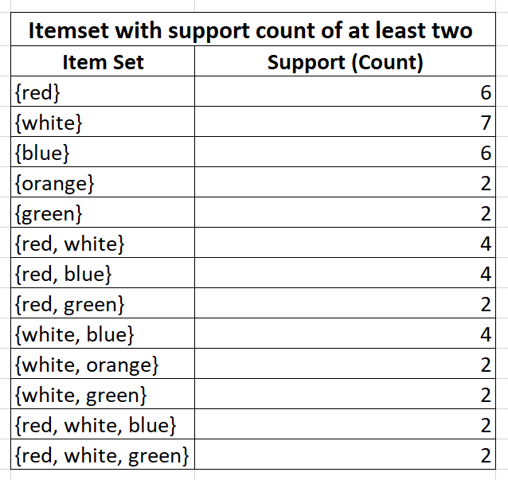
Support
A “frequent” itemset is defined as an itemset that has a support that exceeds a selected minimum support, determined by the user
e.g., itemsets with a support count of at least 2

Slide 17
Apriori Algorithm

Slide 18
Apriori Algorithm
The key idea:
Begin by generating frequent itemsets with just one item (one-itemsets), and recursively generate frequent itemsets of all sizes

Slide 19
Generating Frequent Item Sets
For P products…
User sets a minimum support criterion
Next, generate list of one-item sets that meet the support criterion
Use the list of one-item sets to generate list of two-item sets that meet the support criterion
Use list of two-item sets to generate list of three-item sets
Generating k-itemsets uses the frequent (k-1)-itemsets that were generated in the preceding step
Continue up through P-item sets

Slide 20
Support
A “frequent” itemset is defined as an itemset that has a support that exceeds a selected minimum support, determined by the user
e.g., itemsets with a support count of at least 2

Slide 21
Selecting Strong Rules
Goal: To find only the rules that indicate a strong dependence between the antecedent and consequent itemsets
To measure the strength of association implies by a rule, we use the measures of confidence and lift ratio

Slide 22

Measures of Performance
Confidence: measures the degree of uncertainty about the if-then rule.
$$Confidence= \frac{\# itemset with both antecedent and consequent }{\# itemset with antecedent}$$
A high value of confidence suggests a strong association rule (in which we are highly confident)

Slide 23
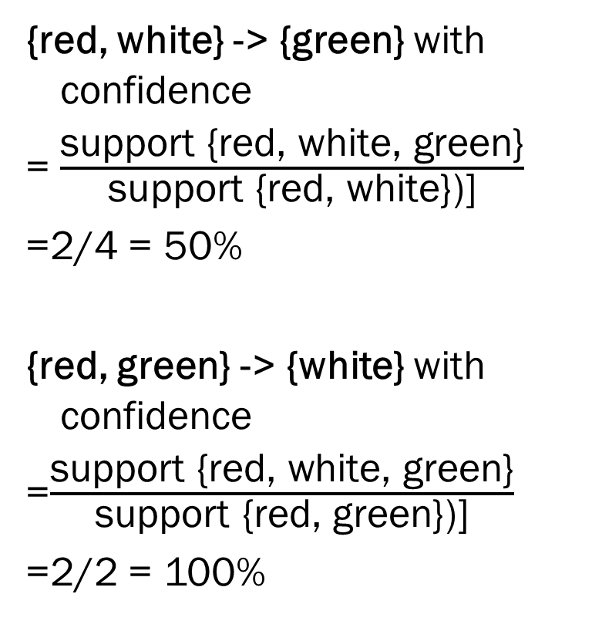
Example: Rules from {red, white, green}
{red, white} -> {green} with confidence
= $\frac{\text{support}\text{ \{}\text{red}\text{, }\text{white}\text{, }\text{green}\text{\}}}{\text{support}\text{ \{}\text{red}\text{, }\text{white}\text{\})]}}$
=2/4 = 50%
{red, green} -> {white} with confidence
=$\frac{\text{support}\text{ \{}\text{red}\text{, }\text{white}\text{, }\text{green}\text{\}}}{\text{support}\text{ \{}\text{red}\text{, }\text{green}\text{\})]}}$
=2/2 = 100%

Slide 24
Example: Rules from {red, white, green}
4 more with confidence of 100%, 33%, 29% & 100%
If confidence criterion is 70%, report only rules 2, 3 and 6

Slide 25
Support vs Confidence
Support is the (estimate) probability that a transaction selected randomly from the database will contain all items in the antecedent and the consequent
Confidence is the (estimated) conditional probability that a transaction selected randomly will include all the items in the consequent given that the transaction includes all the items in the antecedent
A high value of confidence suggests a strong association rule.
However, this can be deceptive.

Slide 26
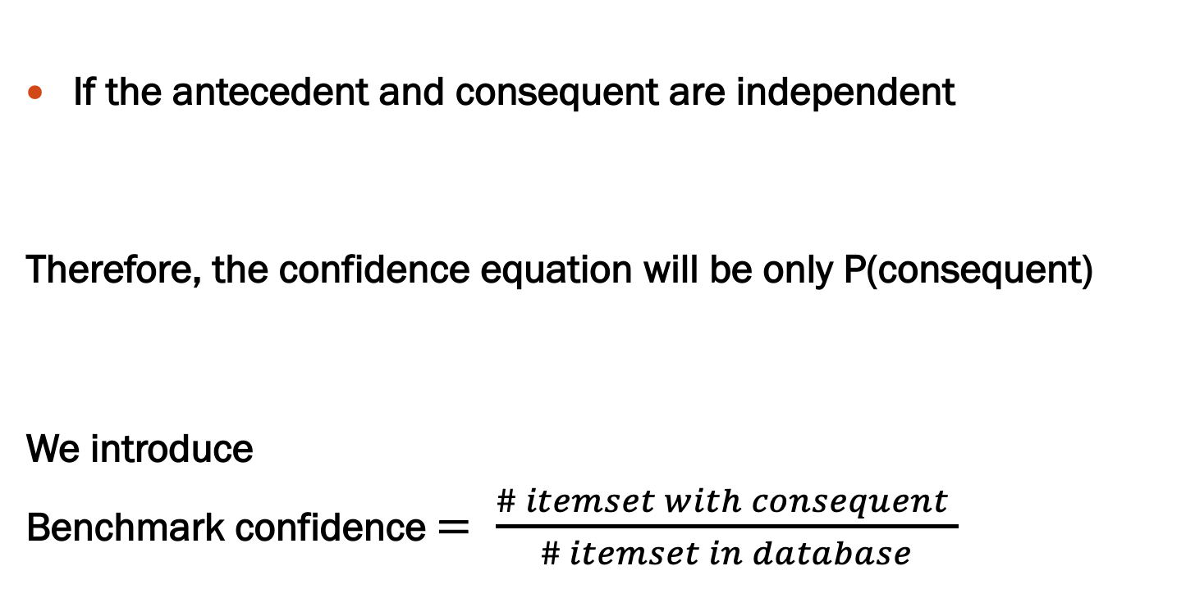
Benchmark Confidence
If the antecedent and consequent are independent
Therefore, the confidence equation will be only P(consequent)
We introduce
Benchmark confidence $= \frac{\# itemset with consequent }{\# itemset in database}$

Slide 27
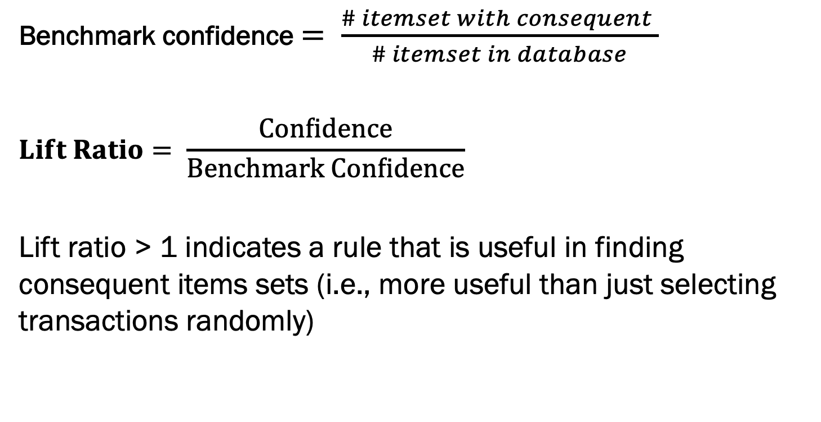
Measures of Performance
Benchmark confidence $= \frac{\# itemset with consequent }{\# itemset in database}$
$$Lift Ratio= \frac{Confidence}{Benchmark Confidence}$$
Lift ratio > 1 indicates a rule that is useful in finding consequent items sets (i.e., more useful than just selecting transactions randomly)

Slide 28
Process of Rule Selection
Generate all rules that meet specified support & confidence
Find frequent item sets (those with sufficient support)
From these item sets, generate rules with sufficient confidence

Slide 29
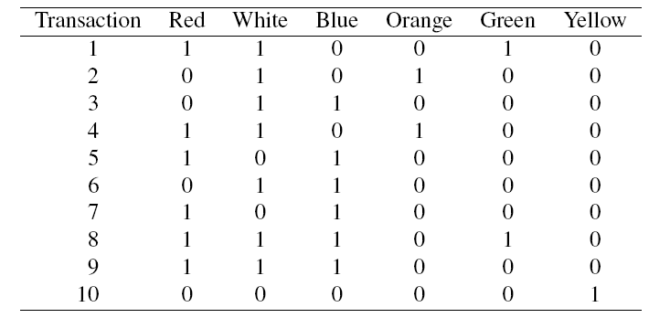
Data Format: Binary Matrix
A transactions database (with each row representing a list of items purchased in a single transaction)
A binary incidence matrix in which columns are items, rows again represent transactions, and each cell has either a 1 or a 0

Slide 30
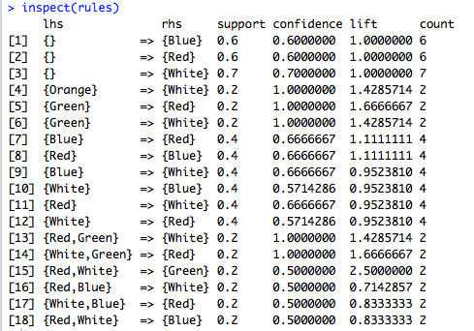
All Rules (support = 0.2, conf = 0.5)
Rule #4:
If orange is purchased, then with confidence 100% white will also be purchased.
This rule has a lift ratio of 1.43 > 1

Slide 31
Interpretation
Support measures overall impact in terms of overall size
(e.g., how many transactions are affected?)
Confidence shows the rate at which consequents will be found (useful in learning costs of promotion)
Lift ratio shows how effective the rule is in finding consequents (useful if finding particular consequents is important)

Slide 32
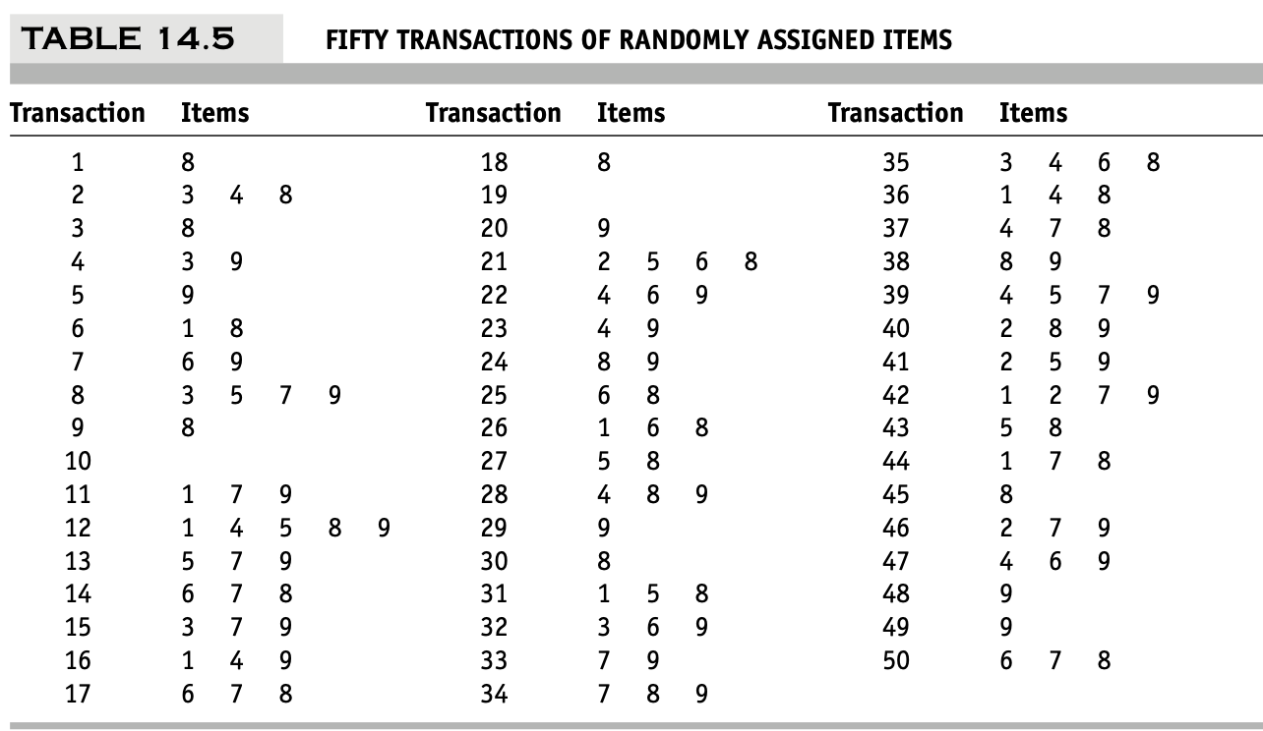
Caution: The Role of Chance
Random data can generate apparently interesting association rules
The more rules you produce, the greater this danger
Rules based on large numbers of records are less subject to this danger

Slide 33
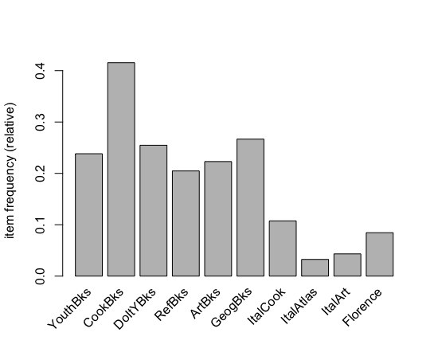
Example: Book Purchases
Examines associations among 2000 transactions involving various types of books

Slide 34
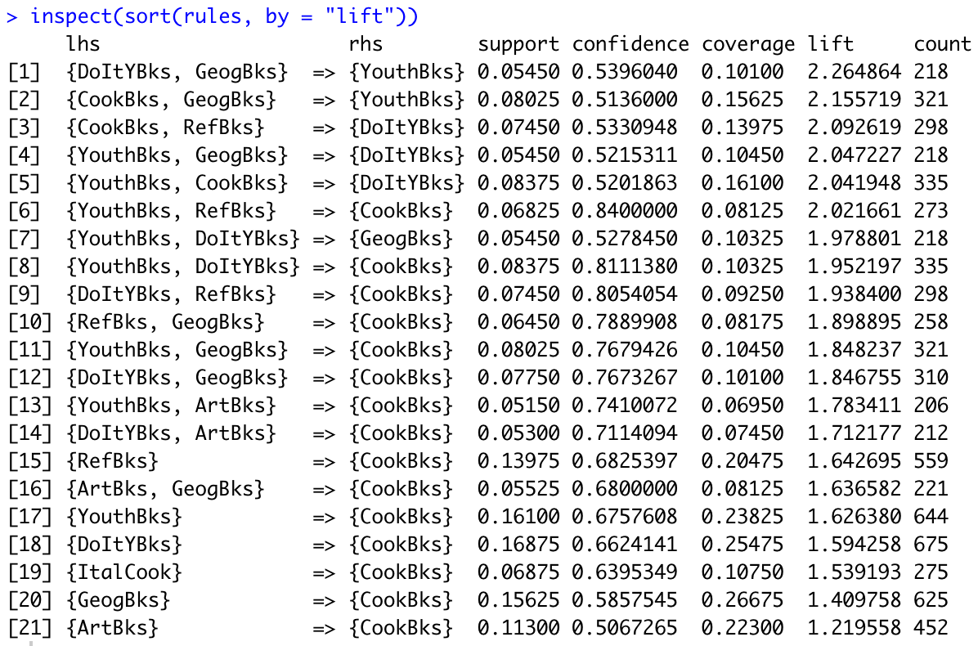
Example: Book Purchases
Rule [19]: “If Italian cooking books have been purchased, then cookbooks are purchased.”
It seems likely that Italian cooking books are simply a subset of cookbooks.

Slide 35
Summary
Association rules (or affinity analysis, or market basket analysis) produce rules on associations between items from a database of transactions
Widely used in recommender systems
Most popular method is Apriori algorithm (1993)
To reduce computation, we consider only “frequent” item sets (=support)
Performance is measured by confidence and lift
Review is required to identify useful rules and to reduce redundancy

